Slide 1
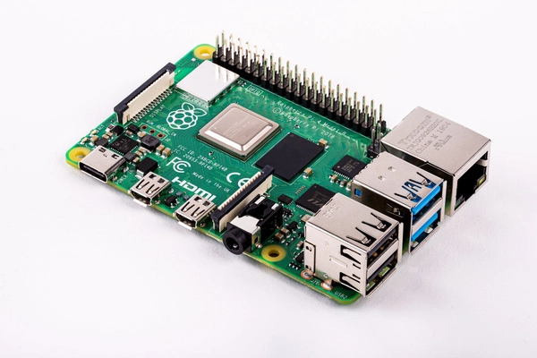
Intro to Hacking with the Raspberry Pi
Sarah Withee
@geekygirlsarah
Slides at geekygirlsarah.com/raspberrypi

Slide 2
A Few Questions To Start…
Who has heard of the Raspberry Pi?
Who owns at least one?
Is it sitting in a closet/junk drawer?
Are you daunted at the idea of tinkering with hardware or electronics?
This talk is probably for you!

Slide 3
A Few Questions To Start…
If you:
understand circuitry basics,
are familiar with breadboards and wiring,
and know how to program GPIO pins on the Pi
This talk may not be for you.
(I won’t be offended if you leave)

Slide 4

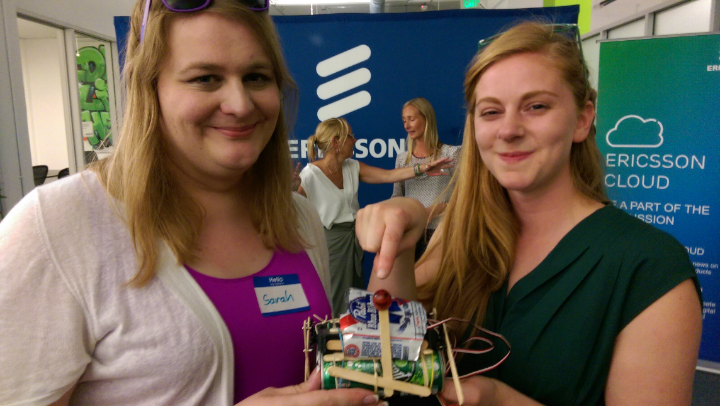
Hello!
I am Sarah Withee
Friendly polyglot
software engineer
Hardware tinkerer
Robot builder
Artificial pancreas user
You can find me at @geekygirlsarah
Simone Giertz, Bruce the Stupid Robot, and I at a bad robot building workshop

Slide 5
Breakdown
Raspberry Pi Information and Models
Intro to Hardware
Intro to Programming Hardware
Project 1 - LEDs
Project 2 - Sensors
Project 3 – Push Buttons and LCD screen
Future Project Inspiration
Conclusion

Slide 6
“The Raspberry Pi is a credit card–sized computer that plugs into your TV or display, and a keyboard and mouse. You can use it to learn coding and to build electronics projects, and for many of the things that your desktop PC does, like spreadsheets, word processing, browsing the internet, and playing games. It also plays high-definition video. The Raspberry Pi is being used by adults and children all over the world to learn programming and digital making.”
Raspberry Pi Foundation, raspberrypi.org/faqs

Slide 7
“We are taking back the term ‘Hacking’ which has been soured in the public mind. Hacking is an art form that uses something in a way in which it was not originally intended. This highly creative activity can be highly technical, simply clever, or both. Hackers bask in the glory of building it instead of buying it, repairing it rather than trashing it, and raiding their junk bins for new projects every time they can steal a few moments away.”
Hackaday, hackaday.com/about/

Slide 8

Resources
very code
Slides, code, diagrams,
videos, and more!
geekygirlsarah.com/raspberrypi
much resources
how to pi
total wow

Slide 9
1.
Raspberry Pi Information and Models
The basics of this delicious computer

Slide 10
History of the Raspberry Pi
2006 – Had idea for affordable computer for kids
2008 – Processors became cheap enough to make it feasible to build
2011 – 50 alpha boards, 25 beta boards, 10,000 production boards
2012 – Sold first units
2013 – Sold > 2M units
2015 – Pi 2 Model B and Pi Zero released
2016 – Pi 3 Model b released
2017 – Pi Zero W released
2018 – Pi Zero WH, 3 B+, 3 A+ released
2019 – Pi 4 B released

Slide 11
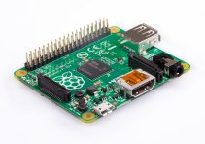
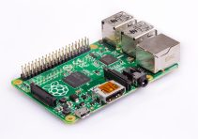
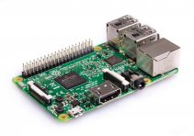
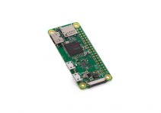
Raspberry Pi Models
Pi Model A+
Pi 3 Model B+
Pi Model B+
Pi 4 Model B
Pi 2 Model B
Pi Zero W/WH

Slide 12
Raspberry Pi Model Comparisons
Model | Processor * | Speed | Memory (shared w/GPU) | Audio/Video | USB Ports ** | Ethernet, Wireless, Bluetooth | Cost | Minimum Power ***
A+ | ARMv6 | 700MHz | 512MB | HDMI, 3.5mm | 1 | None | $20 | 700mA
B+ | ARMv6 | 700MHz | 512MB | “ | 4 | 100 mbps | $25 | 1.8A
2 B | ARMv7 Quad | 900MHz | 1GB | “ | 4 | 100 mbps | $30 | 1.8A
3 B+ | ARMv8 Quad | 1.4GHz | 1GB | “ | 4 | Gigabit, 802.11ac, BT 4.2 | $35 | 2.5A
4 B | ARMv8 Quad | 1.5GHz | 1GB, 2GB, 4GB | 2 Micro HDMI | 2 USB2 2 USB3 | Gigabit, 802.11ac, BT 5.0 | $35, $45, $55 | 2.5A (low) 3.0A (recommended)
Zero | ARMv6 | 1.0GHz | 512MB | Micro SD | 1 | None | $5 | 1.2A
Zero WH | ARMv6 | 1.0GHz | 512MB | Mini HDMI | 1 | 801.11n, BT 4.1 | $10 | 1.2A
* ARMv6 are 32-bit. ARMv8 are 64-bit.
** USB ports are 2.0 unless specified
*** All are Micro USB powered except the 4B which is USB-C.

Slide 13
Raspberry Pi Model Comparisons
Bonus:
All A+, B+, 2, 3, and 4 boards are
backward compatible with each other!
(Pin configurations and board layout)

Slide 14
2.
Intro to Hardware
Wires and circuits and breadboards, oh my!

Slide 15
Circuits
⚡
A complete route that electricity can travel through

Slide 16
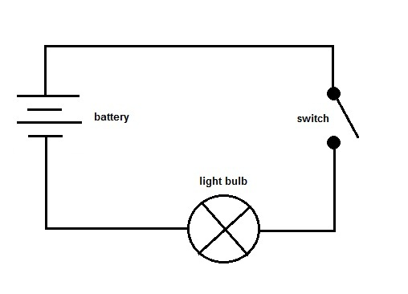
Intro to Hardware – Circuits
Series Circuit
Electricity can flow one direction
Close the switch to make the complete path
Open the switch to stop the electric flow

Slide 17

Intro to Hardware – Circuits
Parallel Circuit
Electricity can flow more than one direction
Close the switch to make both paths complete
Open the switch to stop all the flow

Slide 18
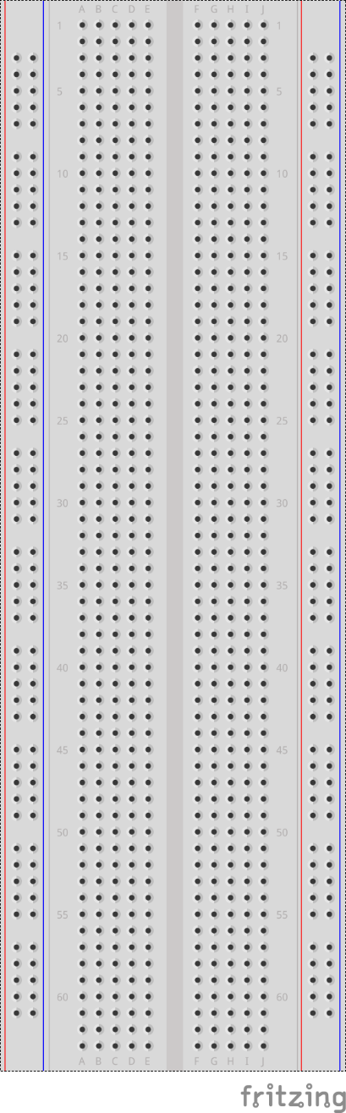
Breadboards
Device to quickly prototype circuits without solder

Slide 19
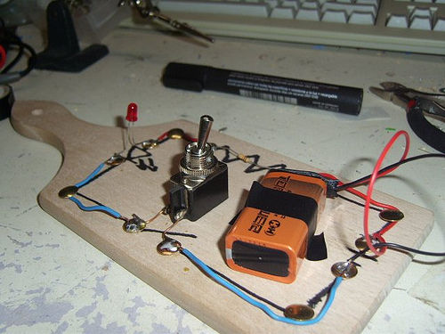
Intro to Hardware - Breadboards
A literal breadboard
(http://www.instructables.com/id/Use-a-real-Bread-Board-for-prototyping-your-circui/)

Slide 20
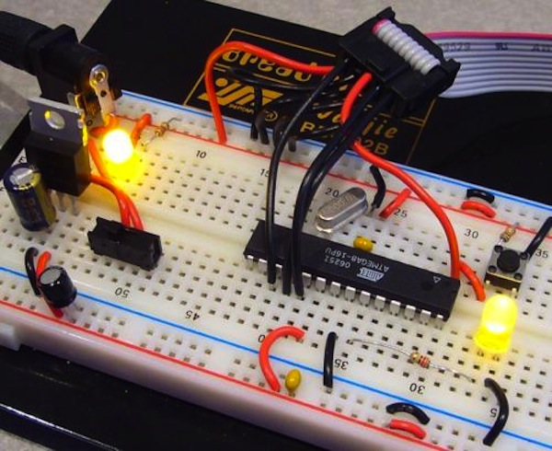
Intro to Hardware - Breadboards
Prototype Circuit
(https://learn.sparkfun.com/tutorials/how-to-use-a-breadboard)

Slide 21
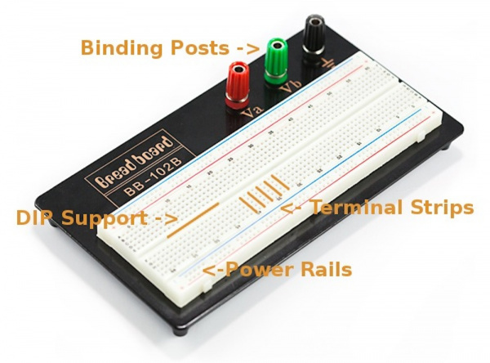
Intro to Hardware - Breadboards
Breadboard features
(https://learn.sparkfun.com/tutorials/how-to-use-a-breadboard)

Slide 22
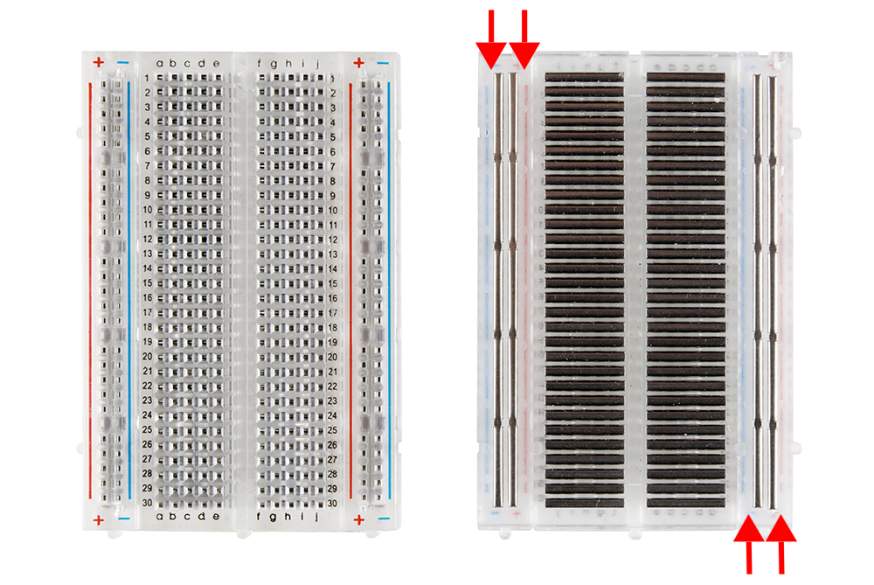
Intro to Hardware - Breadboards
Terminal Strips and Power Rails
(https://learn.sparkfun.com/tutorials/how-to-use-a-breadboard)

Slide 23
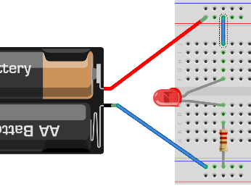
Intro to Hardware – Breadboards
Circuits on Breadboards
Provide power to the power rails
Red – positive
Black/blue – negative
Use wires to connect components together

Slide 24
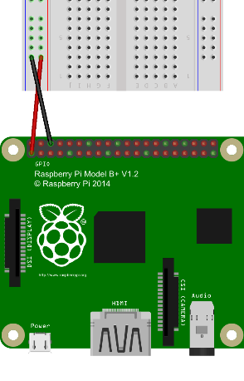
Intro to Hardware – Breadboards
Circuits with Raspberry Pis
Use pin labeled “+3.3V” (volts) for positive
Use pin labeled “Ground” (GND) for negative

Slide 25
Intro to Hardware – Breadboards
Circuits with Raspberry Pis
Note: Arduinos use 5V, be careful not to confuse the two

Slide 26
GPIO
General Purpose Input/Output
Or how our projects “talk” to the Pi

Slide 27
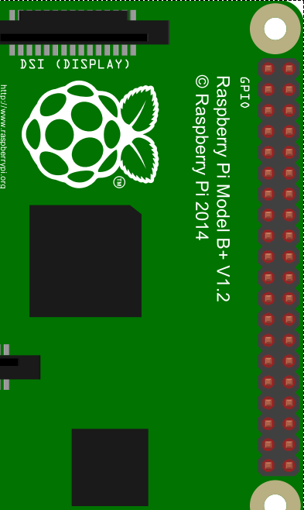
Intro to Hardware – GPIO
Raspberry Pi Pins
40 hardware pins
2 +3.3V
2 +5V
8 Ground
20 GPIO
2 Miscellaneous
Not labeled ON the Pi

Slide 28
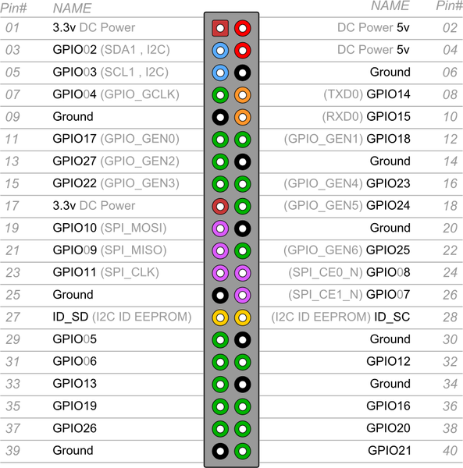
Intro to Hardware – GPIO
Raspberry Pi Pins
Of course, they’re not in any distinguishable order
(Pin diagram available at talk website)

Slide 29
3.
Intro to Programming Hardware
The part you’re really here for

Slide 30
Intro to Programming Hardware
On the Raspberry Pi, Python is built-in with GPIO libraries installed
Other languages available too

Slide 31
Intro to Programming Hardware – Setup Commands
Pin Mode
First, pick your mode
Board – physical pin #
BCM – GPIO pin #

Slide 32
Intro to Programming Hardware – Setup Commands
Next, import the GPIO library:
import Rpi.GPIO as GPIO
Then, set the mode (pick one):
GPIO.setmode(GPIO.BOARD)
GPIO.setmode(GPIO.BCM)

Slide 33
Intro to Programming Hardware – Setup Commands
Pins are set as input or output:
GPIO.setup(3, GPIO.OUT)
GPIO.setup(4, GPIO.IN)
You can change these later
Not setting them causes problems

Slide 34
Intro to Programming Hardware – Output Commands
To write out to the output pins:
(pin number, value)
GPIO.output(3, True)
GPIO.output(10, False)
GPIO.output(6, GPIO.HIGH)
GPIO.output(22, GPIO.LOW)
True/HIGH are “on” (3.3 V)
False/LOW are “off” (0 V)

Slide 35
Intro to Programming Hardware – Input Commands
To read from the input pins:
(pin number)
val = GPIO.input(4)
Values will be True/False or 1/0
(Note: Arduinos have analog value inputs. Raspberry Pis do not.)

Slide 36
Intro to Programming Hardware – Cleanup Commands
Finally, when your program ends, you should “clean up” the pins:
GPIO.cleanup()
This stops reading inputs and stops sending outputs.

Slide 37
Intro to Programming Hardware
Initialization recap:
Import Rpi.GPIO library
Set pin mode (GPIO.BOARD or GPIO.BCM)
Set up input/output pins
Runtime recap:
Output a value to a pin number
Save input value from a pin to a variable

Slide 38
4.
Project 1 - LEDs
The “Hello World” of electronics

Slide 39
Project 1 - LEDs
8 LEDs that blink back and forth
Battlestar Galactica cylon
Knight Rider KITT car

Slide 40
Project 1 - LEDs

Slide 41
Project 1 - LEDs
Materials:
Raspberry Pi and power supply
1 breadboard
8 LEDs
8 resistors
9 jumper wires

Slide 42
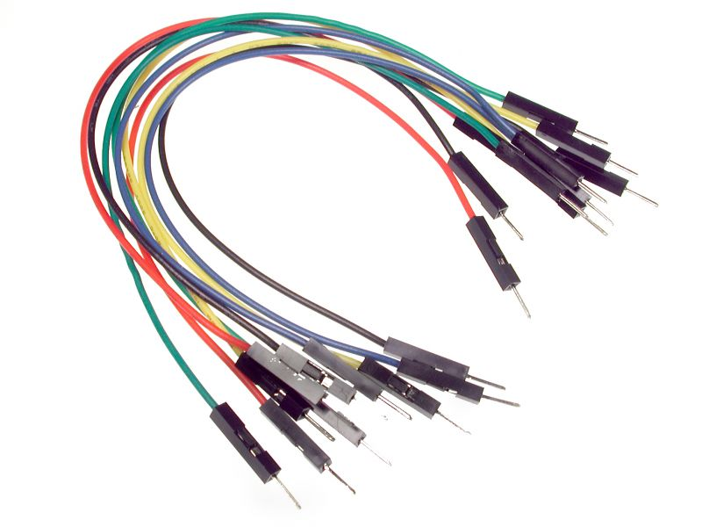
Jumper Wires
Pre-cut wires for prototyping with breadboards

Slide 43
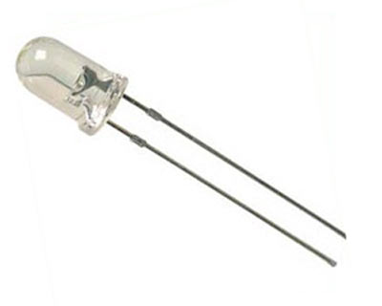
LED
Light-emiting diode
Like a small light bulb

Slide 44
Project 1 - LEDs
LEDs
Diode – ensures electricity only goes one direction
(Wired wrong, it doesn’t work)
Anode – longer wire (+)
Cathode – shorter wire (-)
ALWAYS use a resistor

Slide 45
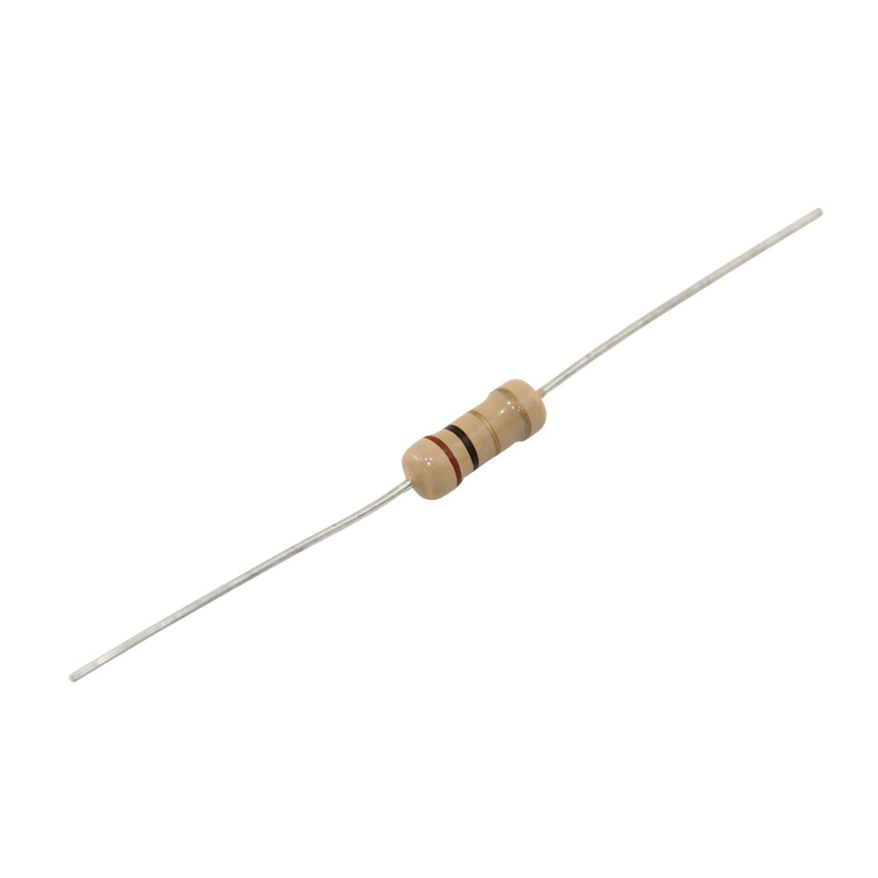
Resistor
Slows down (or resists) the flow of electricity

Slide 46
Project 1 - LEDs
Resistors
Can wire either direction
Band colors tell resistance value (in Ohms)
Without these, LEDs glow bright white, then element explodes

Slide 47
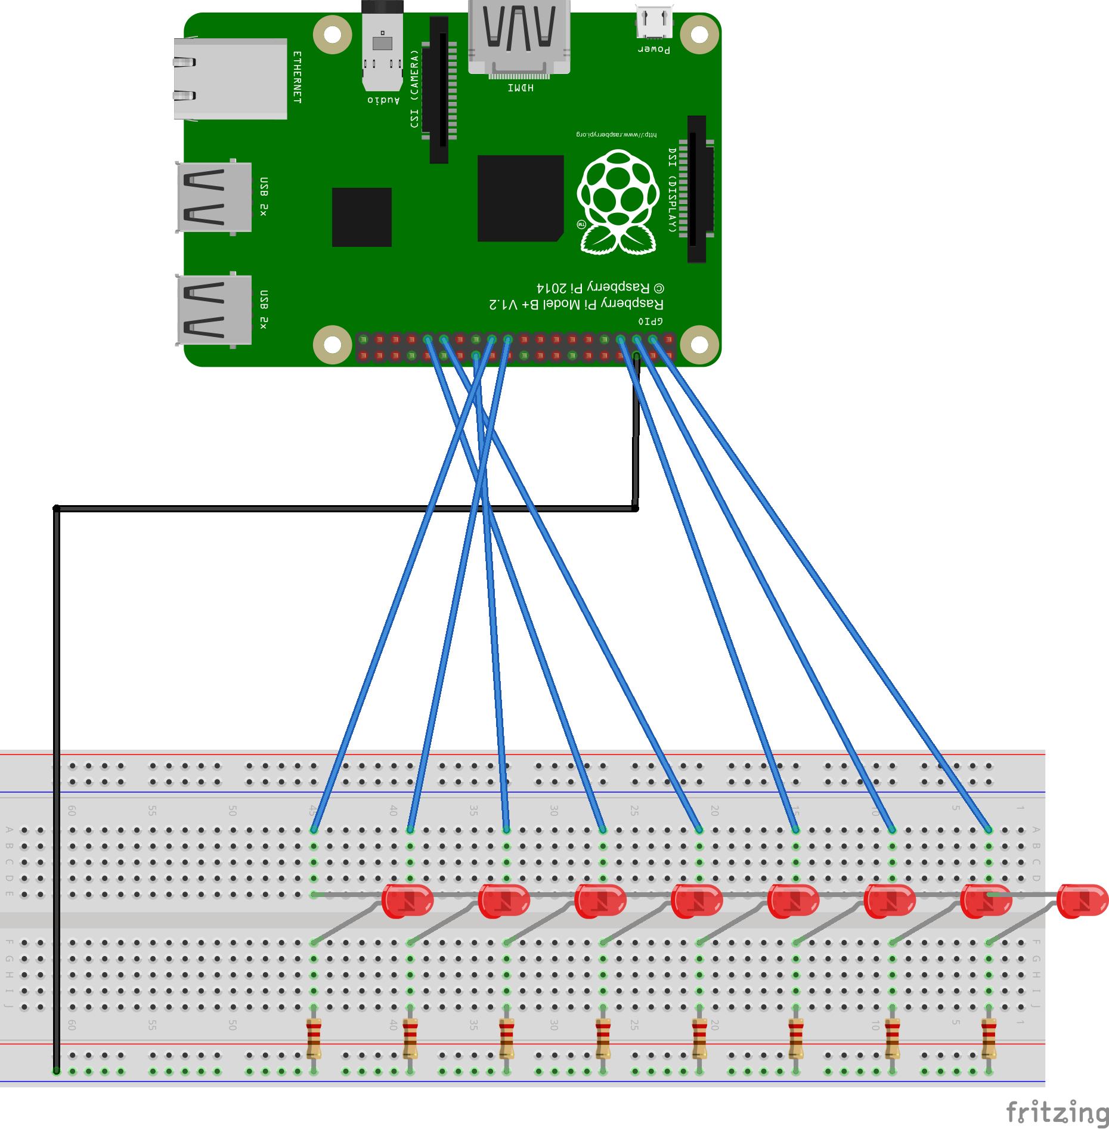
Project 1 - LEDs
Wiring
Wire Pi’s ground to ground rail (black wire)
Plug in LEDs across gap

Slide 48
Project 1 - LEDs
Wiring
Connect resistors from LED cathodes (-) to ground
Connect anodes (+) to Pi GPIO pins
GPIO pins become power sources

Slide 49

Project 1 - LEDs
Programmatically turn on power to blue wires
Return to Ground
Through LED & Resistor
Through blue GND rail

Slide 50
Project 1 - LEDs
# Import libraries
import RPi.GPIO as GPIO
import time
# Create array of GPIO pins
pins = [3, 5, 7, 29, 31, 26, 24, 21]
# Speed lights will blink (secs)
speed = .2 # Cylon-approved speed

Slide 51
Project 1 - LEDs
# Set GPIO pins to board (physical pins) mode
GPIO.setmode(GPIO.BOARD)
# Set up all pins as output pins
for pin in pins:
GPIO.setup(pin, GPIO.OUT)

Slide 52
Project 1 - LEDs
while True:
for i in range(len(pins)):
GPIO.output(pins[i], True)
time.sleep(speed)
GPIO.output(pins[i], False)
for i in range(len(pins)-1, -1, -1):
GPIO.output(pins[i], True)
time.sleep(speed)
GPIO.output(pins[i], False)

Slide 53
Project 1 - LEDs
while True:
for i in range(len(pins)-1):
GPIO.output(pins[i], True)
time.sleep(speed)
GPIO.output(pins[i], False)
for i in range(len(pins)-1, 0, -1):
GPIO.output(pins[i], True)
time.sleep(speed)
GPIO.output(pins[i], False)

Slide 54
Project 1 - LEDs

Slide 55
5.
Project 2 – Sensors
Teaching computers to see.
Or something.

Slide 56
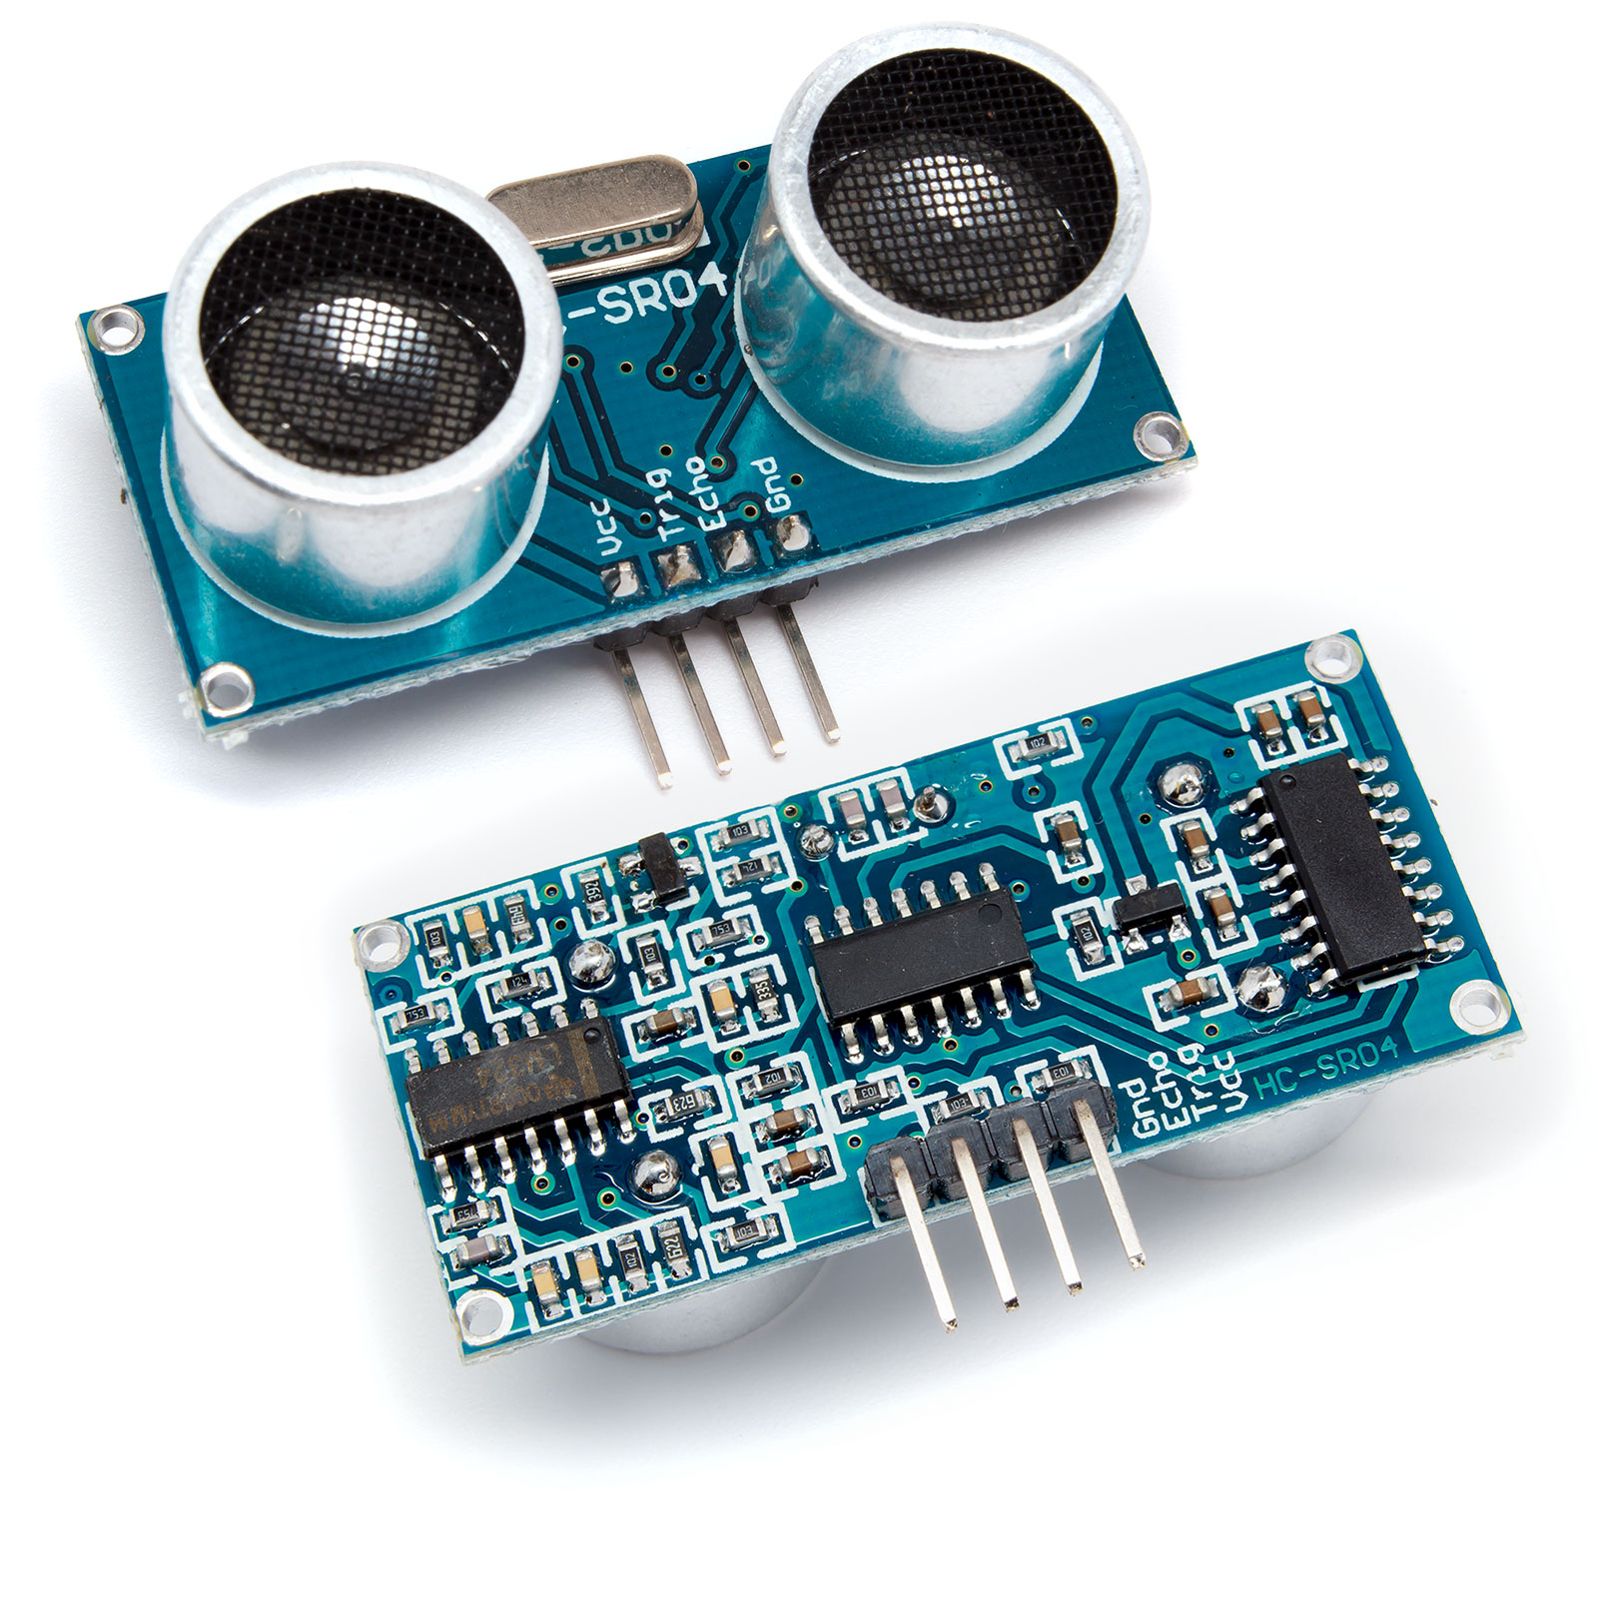
Ultrasonic Distance Sensor
Looks like robot, but measures distance with timed sound waves

Slide 57
Project 2 - Sensors
Ultrasonic Distance Sensor
Sends ultrasonic (high-pitched 40KHz) sound wave
Detects time it takes for sound to bounce back
Time tells it the distance

Slide 58
Project 2 - Sensors
Ultrasonic Distance Sensor
4 pins:
VCC (power)
Trig (trigger)
Echo
GND (ground)
One side transmits, one receives

Slide 59
Project 2 - Sensors
Ultrasonic Distance Sensor
Note: this works on 5V!
Don’t mix 3.3V and 5V together! (5V is bad for GPIO pins)
Use 1K resistor on Echo pin

Slide 60
Project 2 - Sensors

Slide 61
Project 2 - Sensors
Materials:
Raspberry Pi and power supply
1 breadboard
1 ultrasonic sensor (HC-SR04)
6 LEDs
6 resistors for LEDs
1 1K resistor
Jumper wires

Slide 62
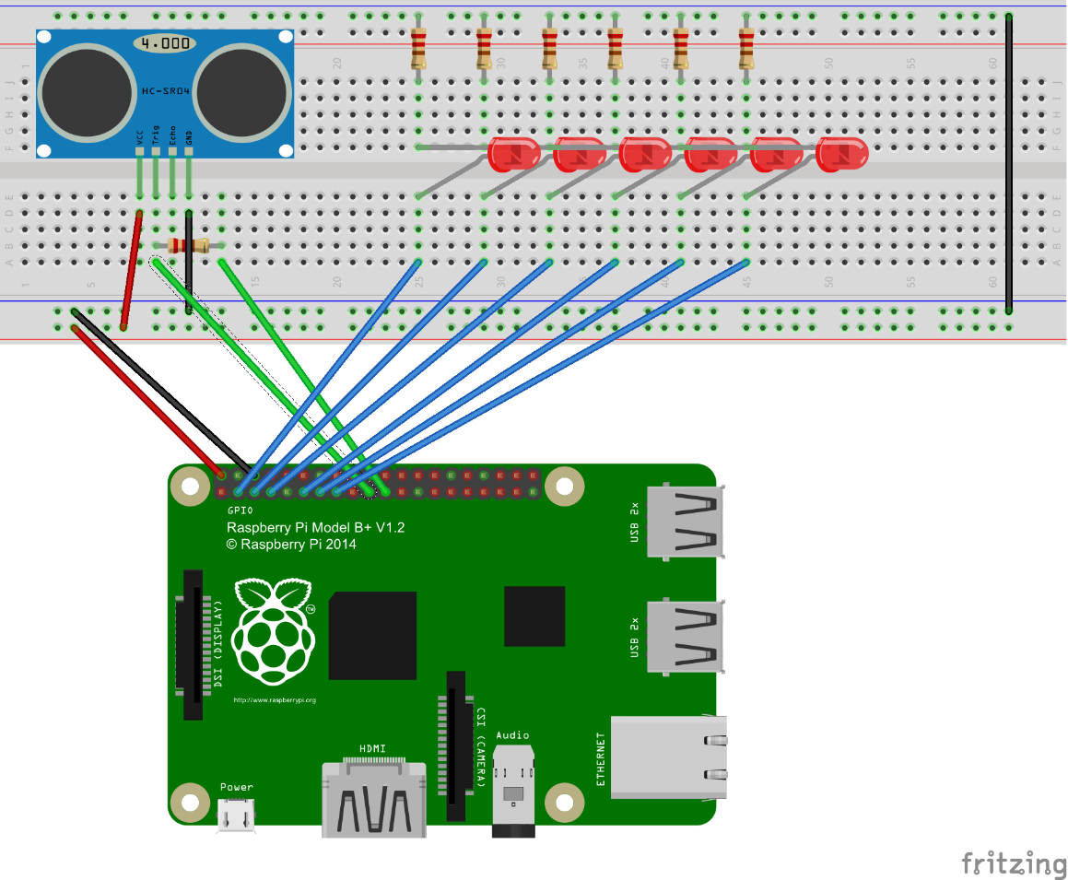
Project 2 - Sensors
Wiring
Wire Pi’s ground to ground rail (black)
Wire Pi’s +5V to power rail (red)
Wire both ground rails together (black wire)

Slide 63
Project 2 - Sensors
Wiring
Wire LEDs and resistors to GPIO pins like in Project 1
Wire Trigger pin to GPIO

Slide 64
Project 2 - Sensors
Wiring
Wire Echo pin to 1K resistor
Wire 1K resistor to GPIO

Slide 65
Project 2 - Sensors
import time
import RPi.GPIO as GPIO
# Set up the pins
uTrig = 19
uEcho = 21
leds = [3, 5, 7, 11, 13, 15]
GPIO.setup(GPIO.BOARD)
for i in leds:
GPIO.setup(i, GPIO.OUT)
GPIO.output(i, GPIO.LOW) # off

Slide 66
Project 2 - Sensors
def readDistance(trigger, echo):
GPIO.setmode(GPIO.BOARD)
GPIO.setup(trigger, GPIO.OUT)
GPIO.setup(echo, GPIO.IN)
GPIO.output(trigger, GPIO.LOW)
time.sleep(0.3)

Slide 67
Project 2 - Sensors
GPIO.output(trigger, True)
time.sleep(0.00001)
GPIO.output(trigger, False)
signaloff = 0
while GPIO.input(echo) == 0:
signaloff = time.time()

Slide 68
Project 2 - Sensors
signalon = 0
while GPIO.input(echo) == 1:
signalon = time.time()
timepassed = signalon - signaloff
distance = timepassed * 17000
return distance

Slide 69
Project 2 - Sensors
# Main program
while True:
# Grab a reading
read = readDistance (uTrig, uEcho)
for i in range(0, 6):
print(i)
if read > i * 3: # Every 3 cm
GPIO.output(leds[i], GPIO.HIGH)
else:
GPIO.output(leds[i], GPIO.LOW)

Slide 70
Project 2 - Sensors

Slide 71
Intro to Hardware – GPIO
Other Sensors?
Humidity
Carbon dioxide
Hall (magnetic)
Hydrometer
Accelerometer/Gyrometer
Infrared + Photodetectors
Weight
Speed

Slide 72
6.
Project 3 – Push Buttons and LCD screens
Push it, push it real good

Slide 73
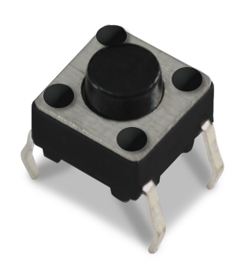
Push Button
It’s a button you push

Slide 74
Project 3 – Push Buttons and LCD screens
Push Button
Connects two pins when pressed
Fits across the breadboard gap

Slide 75
Project 3 – Push Buttons and LCD screens
These two are connected
These two are connected
Pressing button connects all 4

Slide 76
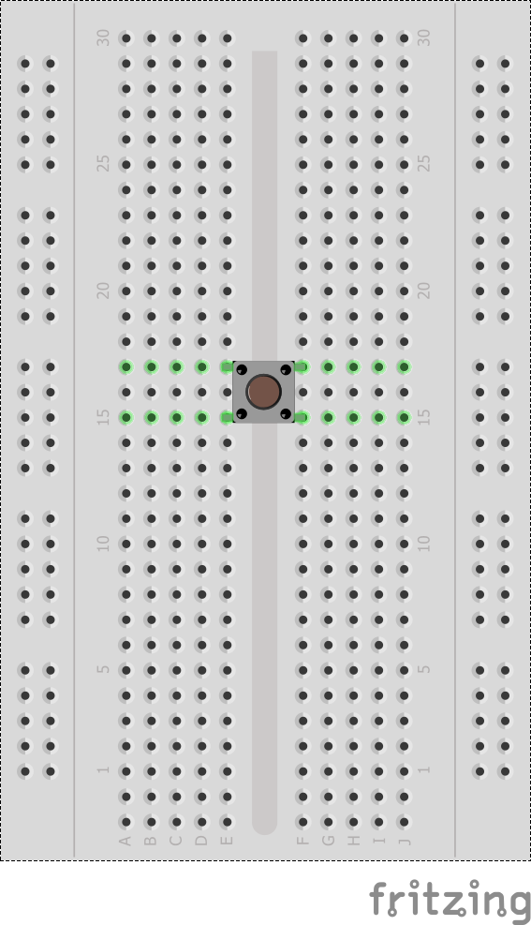
Project 3 – Push Buttons and LCD screens
Push Button
The curved pins should “hug” the breadboard gap

Slide 77
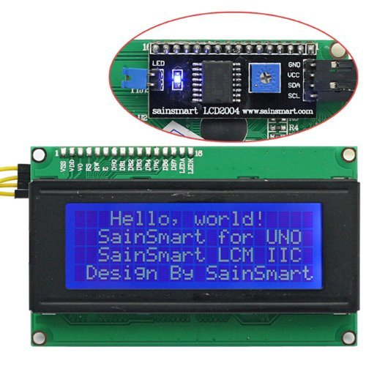
LCD Screen
Screen that can display ASCII characters

Slide 78
Project 3 – Push Buttons and LCD screens
LCD Screen
In a variety of row/col configurations
In a variety of pin configurations, but I recommend the I2C type

Slide 79
I²C
Inter-Integrated Circuit, or “I squared C”
Communication protocol for electronics

Slide 80
Project 3 – Push Buttons and LCD screens
I²C on the Raspberry Pi
It’s not enabled by default
Run sudo raspi-config
Go to Interfacing Options
Then I2C
Then enable
Then reboot

Slide 81
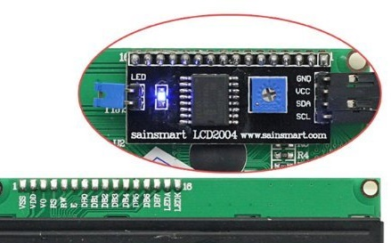
Project 3 – Push Buttons and LCD screens
Wiring the LCD Screen
The 4 wires correspond to the 4 pins on the Pi:
Vcc – +5V
Gnd – Ground
SDA – SDA
SCL – SCL
(Yes, this you hook up to 5V)

Slide 82
Project 3 – Push Buttons and LCD screens

Slide 83
Project 3 – Push Buttons and LCD screens
Materials:
Raspberry Pi and power supply
1 breadboard
3 push buttons
3 LEDs and resistors
1 LCD screen
Jumper wires

Slide 84
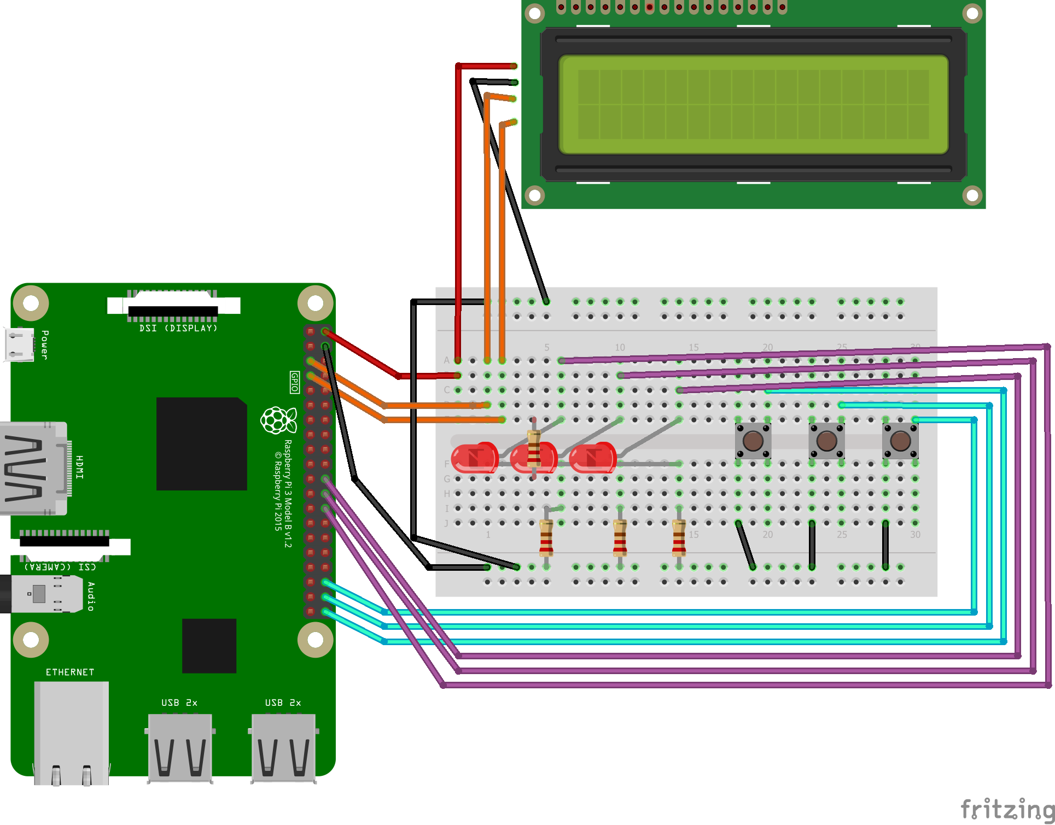
Project 3 – Push Buttons and LCD screens
Wiring
Connect ground to black rail
Connect LEDs like in project 1
(GPIO->LED->resistor->ground) (purple wires)

Slide 85
Project 3 – Push Buttons and LCD screens
Wiring
Connect one side of each button to Ground (black wires)
Connect other side to GPIOs (cyan wires)

Slide 86
Project 3 – Push Buttons and LCD screens
Wiring
Connect LCD’s Ground to Ground
Connect LCD’s Vcc to +5V on pi
Connect SDA/SCL to Pi pins 3/5 (orange wires)

Slide 87
Project 3 – Push Buttons and LCD screens
(Open code in editor)

Slide 88
Project 3 – Push Buttons and LCD screens

Slide 89
7.
Future Project Inspiration
Time to flap those electronic wings and fly!

Slide 90
Future Project Inspiration
Assorted ideas I’ve heard of:
Customized cookie maker machine
Show tweets/emails on LCD screen
AI-programmed remote control cars
Robots… of any variety…
Home automation (control heater/AC, control lights when in room, etc.)

Slide 91
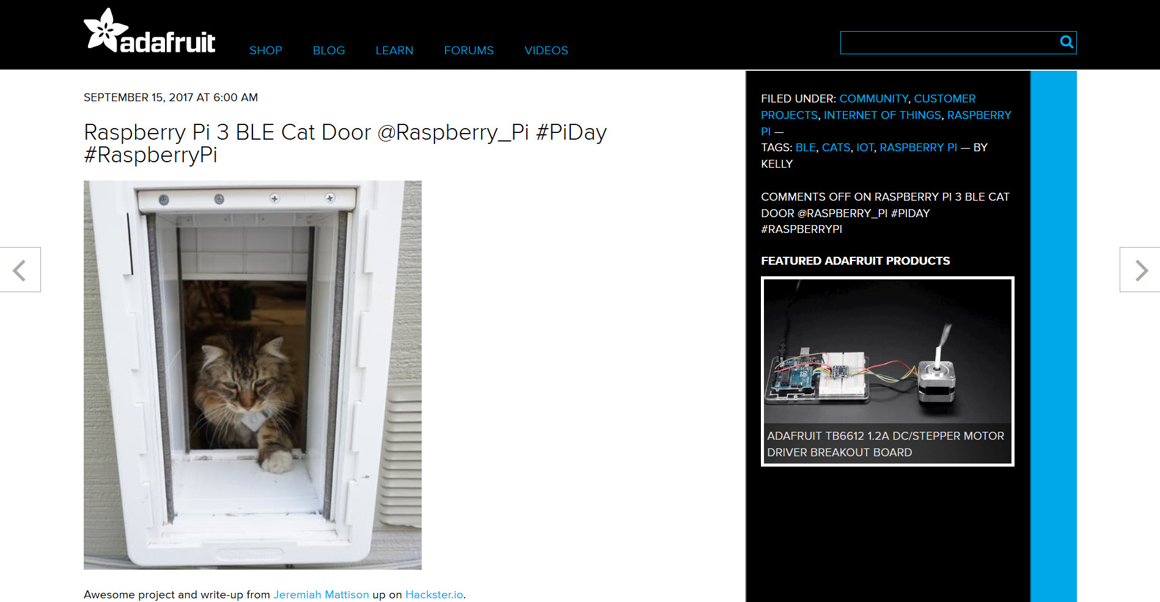
Future Project Inspiration
Pi Bluetooth Low Energy Cat Door
https://blog.adafruit.com/2017/09/15/rpi-3-ble-cat-door-raspberry_pi-piday-raspberrypi/

Slide 92

Future Project Inspiration
Christmas Light Controller System
https://chivalrytimberz.wordpress.com/2012/12/03/pi-lights/

Slide 93

Future Project Inspiration
Pi-Powered CNC Oreo customizing machine
https://blog.adafruit.com/2014/03/14/peek-inside-a-pi-powered-cnc-oreo-customizing-machine-raspberry_pi-piday-raspberrypi/, start at 3:40

Slide 94
Future Project Inspiration
Where can I buy parts?
Pi: raspberrypi.org (NOT Amazon)
Power supply: MicroCenter, Amazon, ~$10
Breadboard: MicroCenter, Amazon, $4-7
Jumpers: Amazon, $3-7 for sets
LEDs: Buy as kit (LEDs + resistors) on Amazon or electronic stores, $3
Sensors: Amazon has kits for $15-40
(like https://www.amazon.com/OSOYOO-Modules-Mega2560-Raspberry-Learning/dp/B00WQY2704/)

Slide 95
Future Project Inspiration
Final thoughts:
Development projects always take longer than you think. More so with hardware.
Hardware sometimes fails randomly. If software quits working, try testing hardware.
You’re welcome to ask me questions!

Slide 96
8.
Conclusion
It all must come to an end…

Slide 97
Conclusion
Raspberry Pi is a PC, but can interface easily with electronics with GPIO pins
You’ve seen a variety of sample projects and parts and how to code with them
Hopefully you’re inspired to hack together your own projects

Slide 98
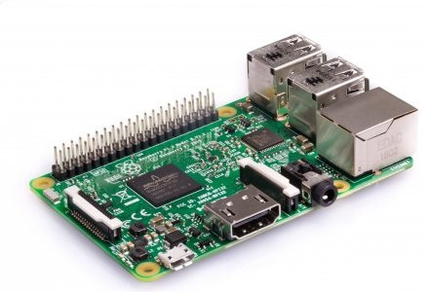
Thanks!
Slides: geekygirlsarah.com/raspberrypi
Share your stories and questions!
Twitter: @geekygirlsarah
Email: hello@geekygirlsarah.com

